Slide 1
BC Code Review Final Presentation
Christina Nguyen, Sarah Ramazani, Michael Bloomquist, Travis Lamb

Slide 2
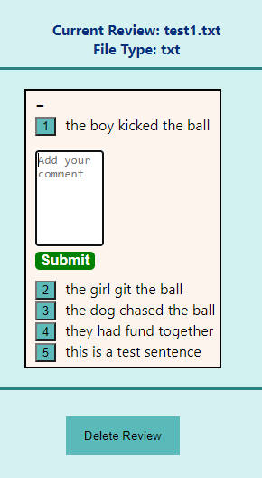
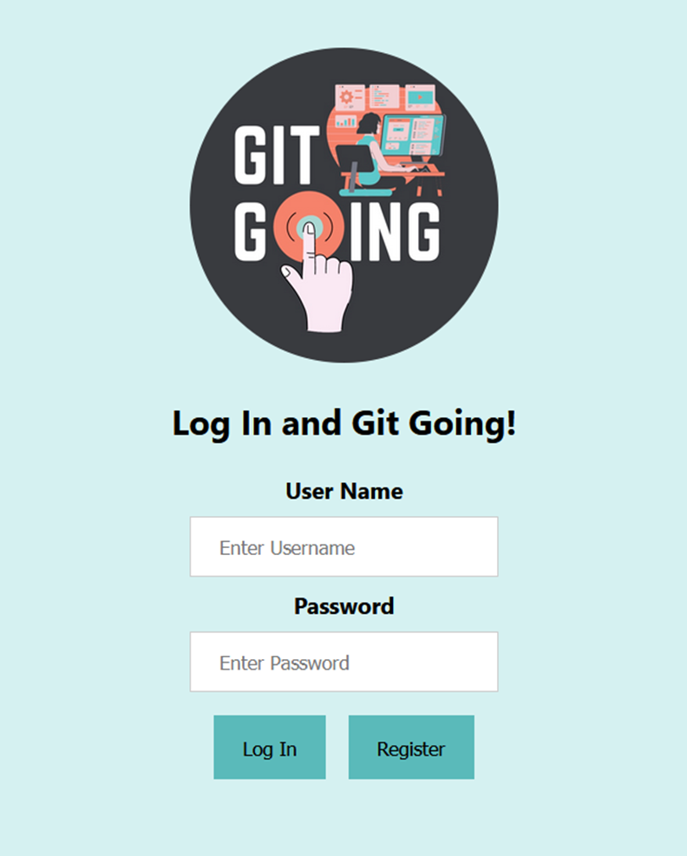
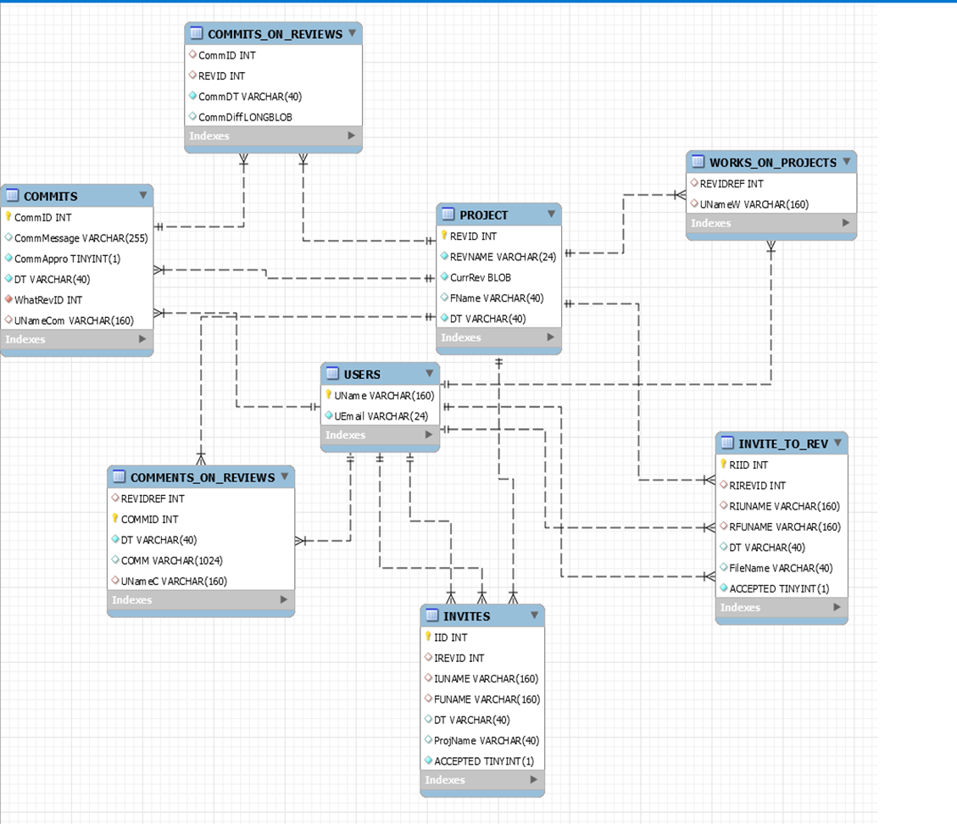
Where we were
Authentication System
Simple Email Service
Simple Queue Service
Database System
File Contents
User Information
Inline Commenting

Slide 3
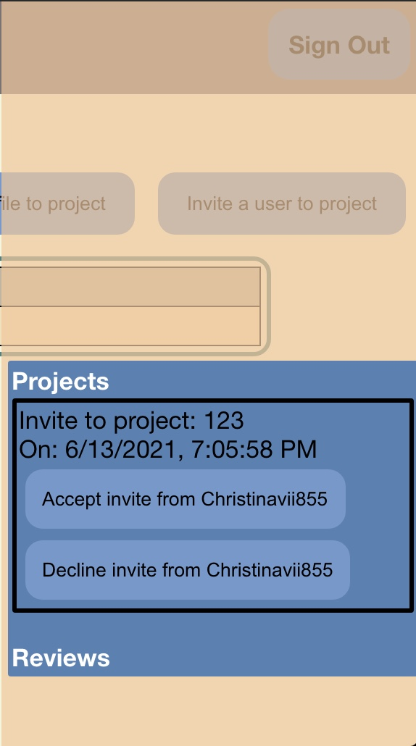
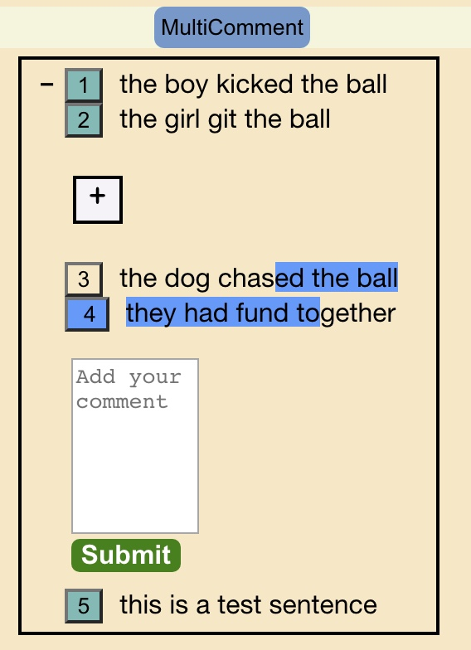
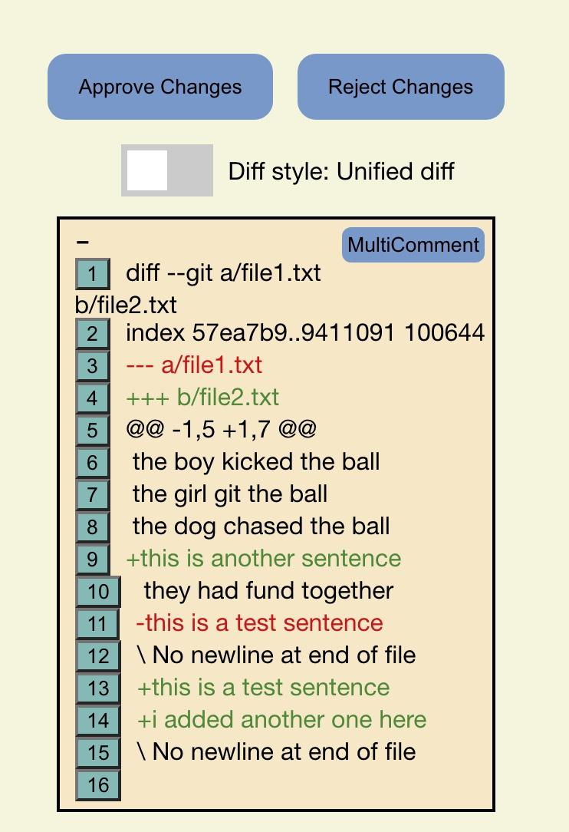
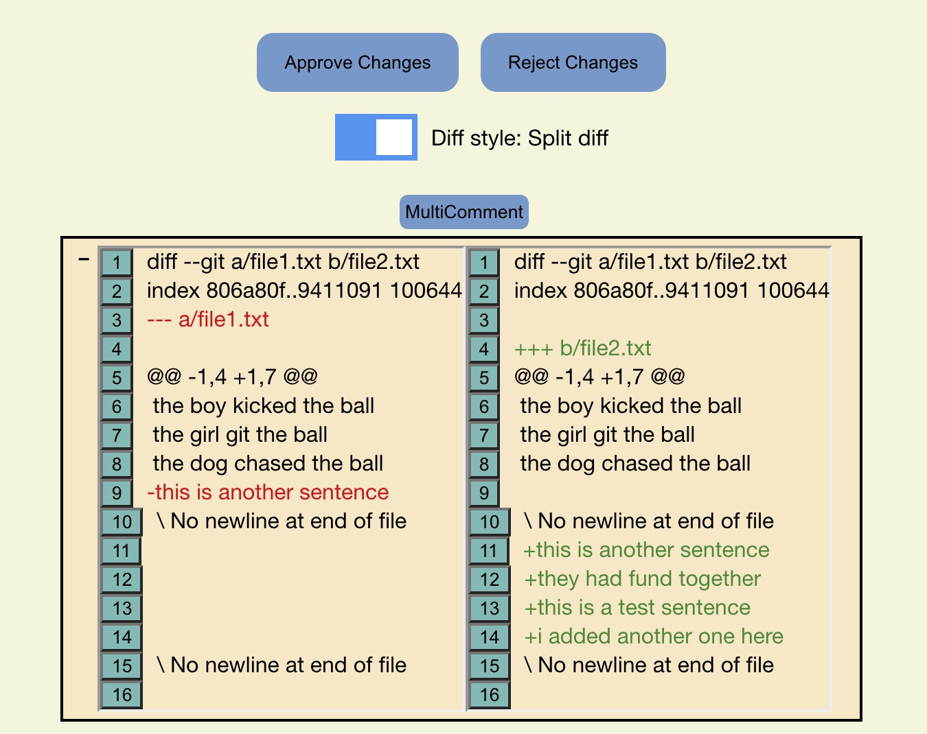
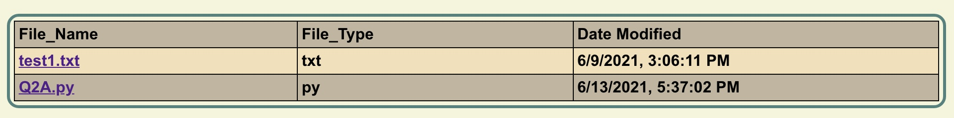
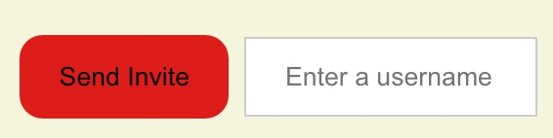
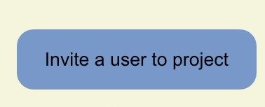


Where we are
Automatic retrieval of diffs when a file is updated
Implementation of the approval/rejection system for reviews
Implementation of file history for projects
Multiline commenting
Notifications

Slide 4
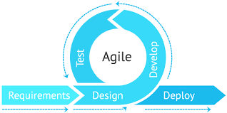
How we got there
Understanding of React components
Storing Comments in Database
Flask app to retrieve diffs
CSS Redesigning
Trial and Error

Slide 5
Biggest Challenges
Hosting
Learning new technologies
React
Amazon Web Services (AWS)
APIs
CSS
Overwhelmed ourselves at times

Slide 6
Things we would do differently
Utilize CI/CD in development
Use Redux or similar for state management
Use more React UI libraries rather than creating all our own components
Get rid of python app, node.js app serves all needs
Use more AWS services (such as S3 or Lambda) over some of our current implementations
Keep code cleaner from day one, to avoid refactoring six months in
Better project planning and management of time

